Slide 1

METTA LPG PTE LTD
2C JALAN PESAWAT JURONG SINGAPORE 619359
EMAIL: enquiry@mettalpg.com
CONTACT: +65-62654933

Slide 2

REGO / GODDARD VALVE
FOR LNG AND CRYOGINIC APPLICATION
MAKE IN USA

Slide 3
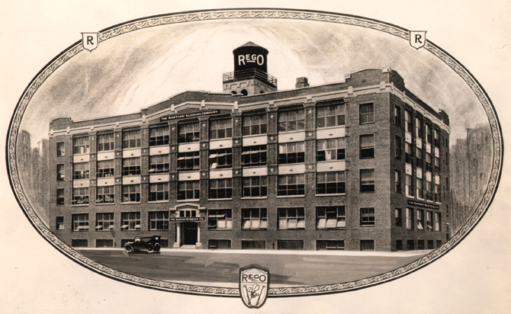
RegO Company West Patterson Avenue Chicago, Illinois
Charles Bastian invents carbon dioxide cylinder valve in 1888

Slide 4
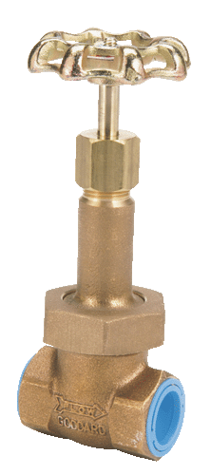
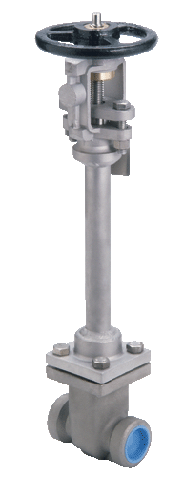
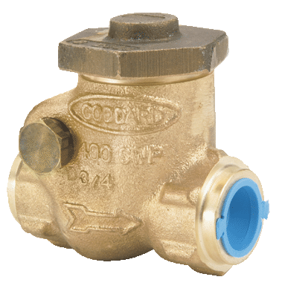
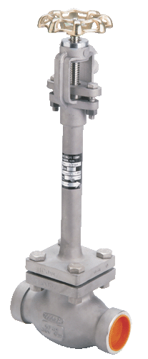
RegO® History of Excellence
Charles Bastian invents carbon dioxide cylinder valve in 1888
Liquid Carbonic , a manufacturer of soda fountains, purchases Bastian’s company
1908 Bastian forms bastian blessing company with colleague Lewis Blessing
1918 Bastian Blessing regulators used for gas welding equipment
Acronym regulator and oxygen becomes RegO
1920’s RegO Company pioneers gas regulator for propane – Bastian splits company into two divisions
1969 RegO becomes separate company and goes though several ownerships
1976 Marmon Group merges Cerro Corporation and RegO under marmon umbrella
RegO moves facility from Chicago to Elon, North Carolina in 1985
Engineered Controls international formed in 1988
ECII builds machining plant in Whitsett, nc in 1988
ECII builds regulator factory in Conover, NC 1998

Slide 5
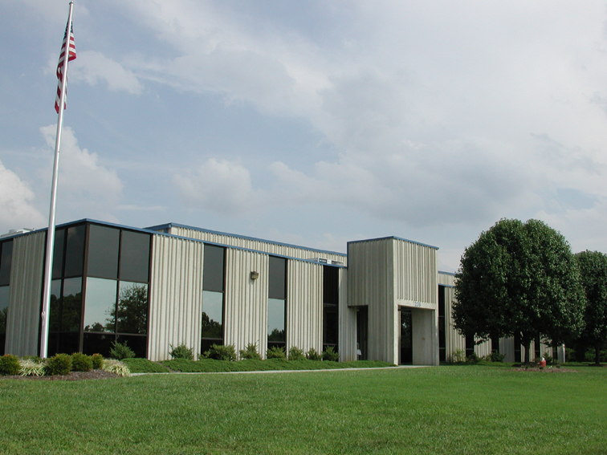
RegO® History of Excellence
ECII - Machining Facility
Rock Creek Industrial Park
Whitsett, North Carolina

Slide 6



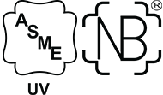
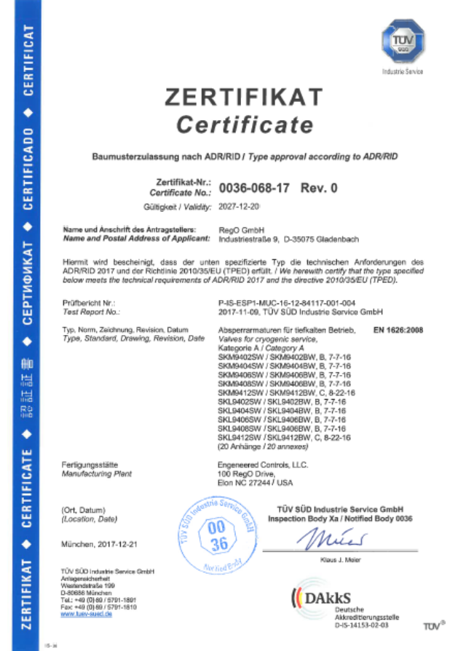
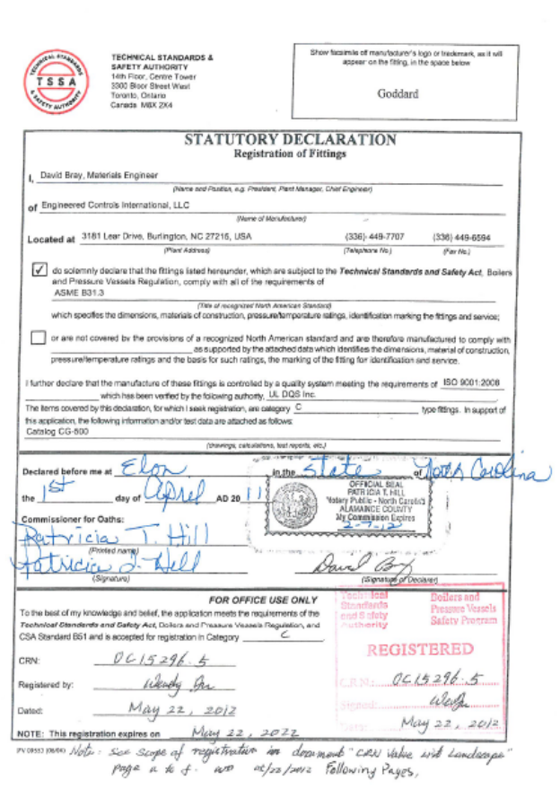
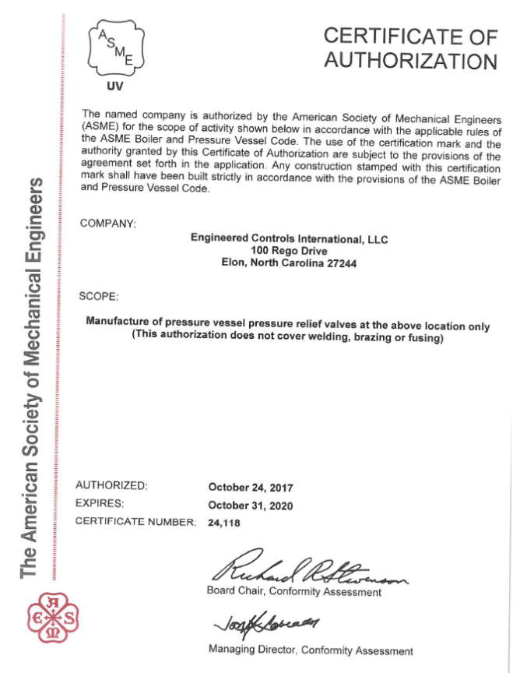
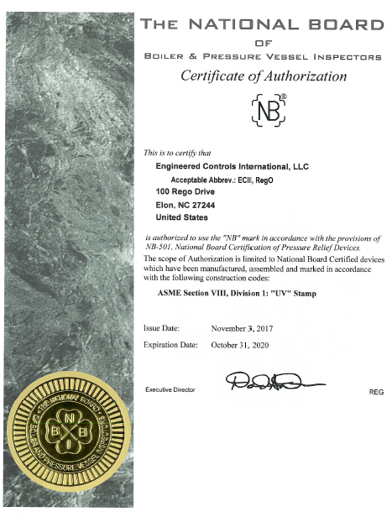
RegO®
CERTIFICATIONS
MORE CERTIFICATIONS REFRE TO WEBSITE: http://www.regoproducts.com/cryo/certifications.html

Slide 7
REGO CRYOGINIC PRODUCTS
According American Society for Testing and Materials
ASTMG93 and CGA G-4.1 which assures removal of visible particles and combustible residues
• Material according to ASTMG93
• Cleaned for liquid oxygen service per CGA G-4.1.
• Maximum working pressure is 609 PSIG. (42 Bar)
• Working temperature range is -320°F to +165°F. (-196ºC to +74ºC)
• 100% Factory Tested

Slide 8
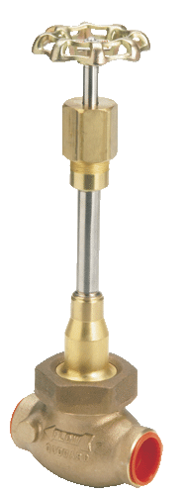
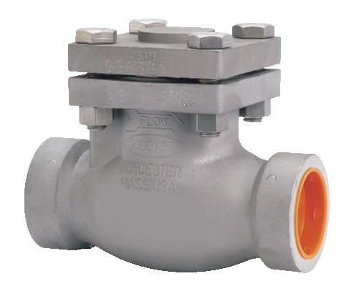
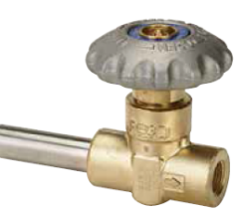
REGO CRYOGINIC PRODUCTS/ LNG TANK MANUFACTURER
According American Society for Testing and Materials
ASTMG93 and CGA G-4.1 which assures removal of visible particles
and combustible residues
BRONZE GLOBE VALVES
BRONZE GATE VALVES
BRONZE CHECK VALVES
SST GLOBE VALVES
SST GATE VALVES
SST CHECK VALVES
SHOT STEM VALVE

Slide 9
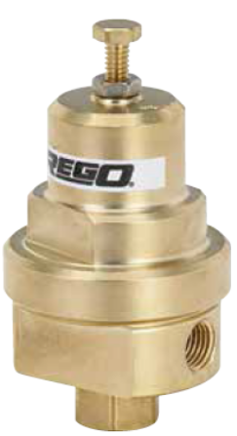
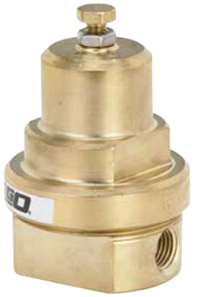
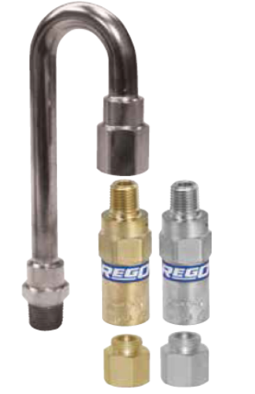
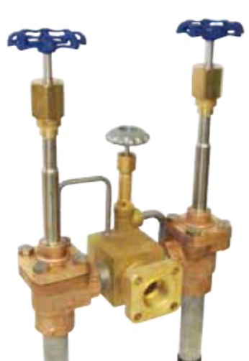
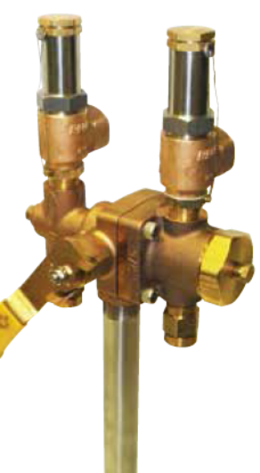
REGO CRYOGINIC PRODUCTS
According to American Society for Testing and Materials
ASTMG93 and CGA G-4.1 which assures removal of visible particles
and combustible residues
Cryogenic Pressure Builder
Cryogenic Economizers
Relief Valves
Cryogenic Fill Manifold
Bulk Vessel Safety Assembly – Relief Valve, Diverter

Slide 10
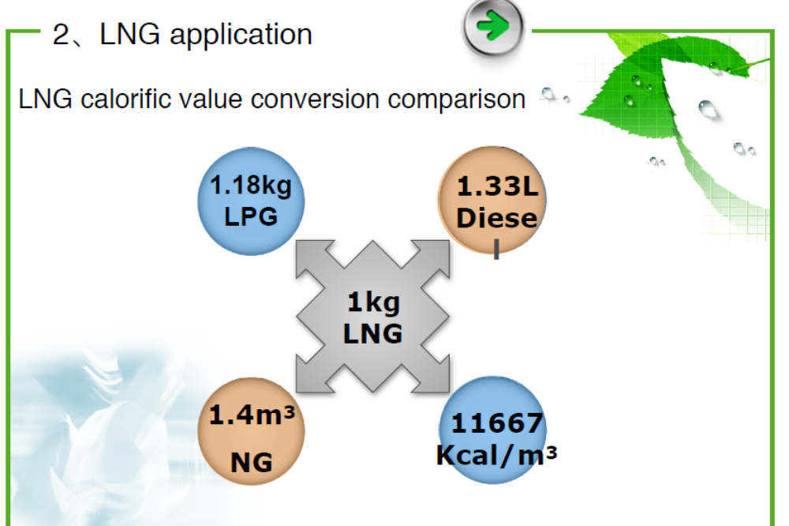
REGO CRYOGINIC PRODUCTS/ LNG TANK MANUFACTURER

Slide 11
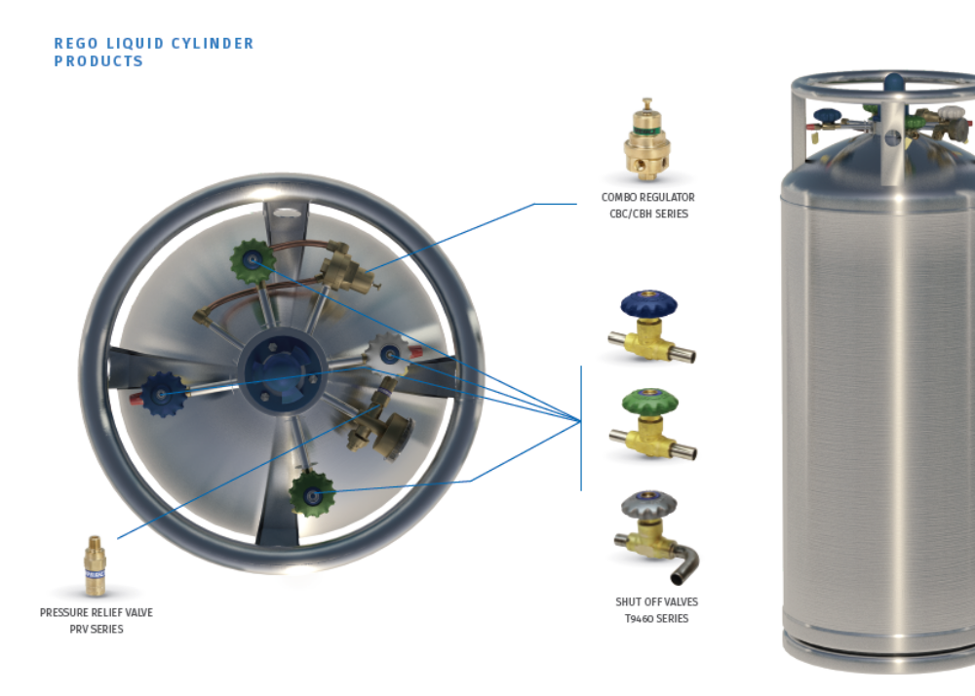
REGO CRYOGINIC PRODUCTS/ LNG TANK MANUFACTURER
COMBO REGULATOR
CBH, CBC SERIES
PRESSURE RELIEF VALVE
SHUT OFF VALVE
T9460 SERIES

Slide 12
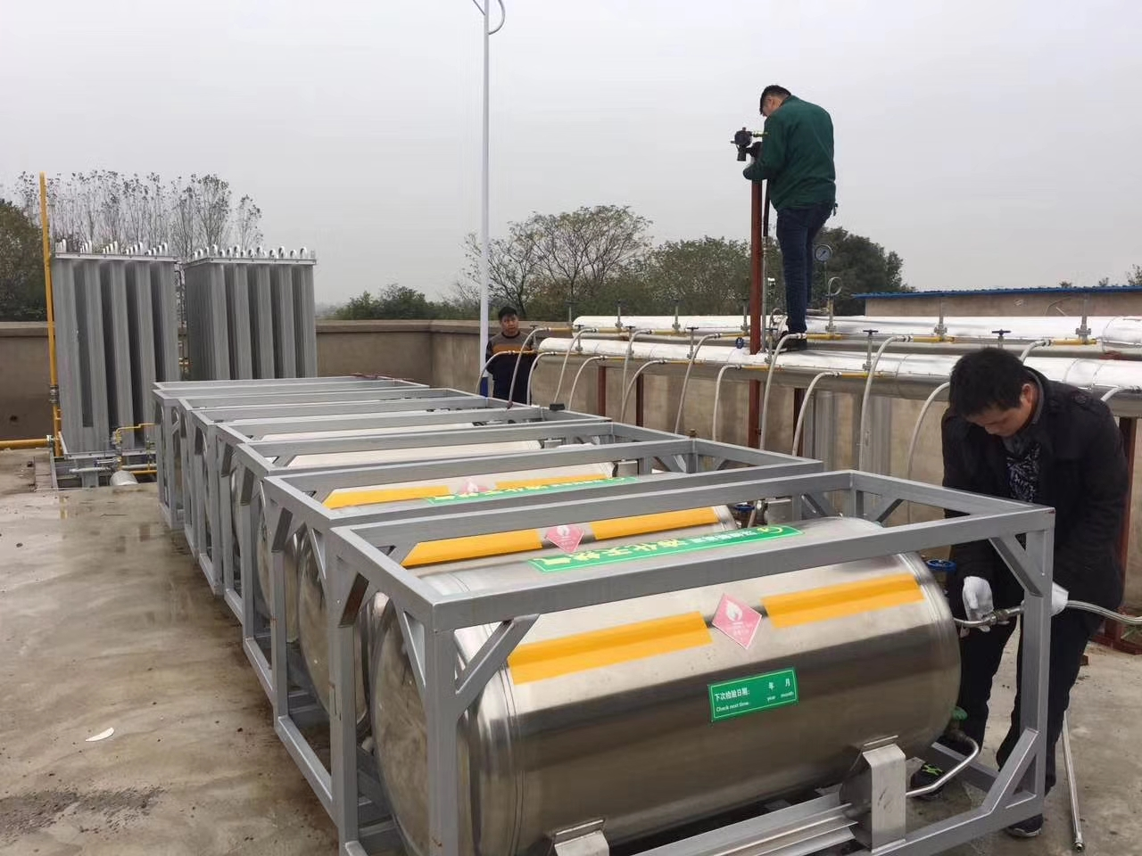
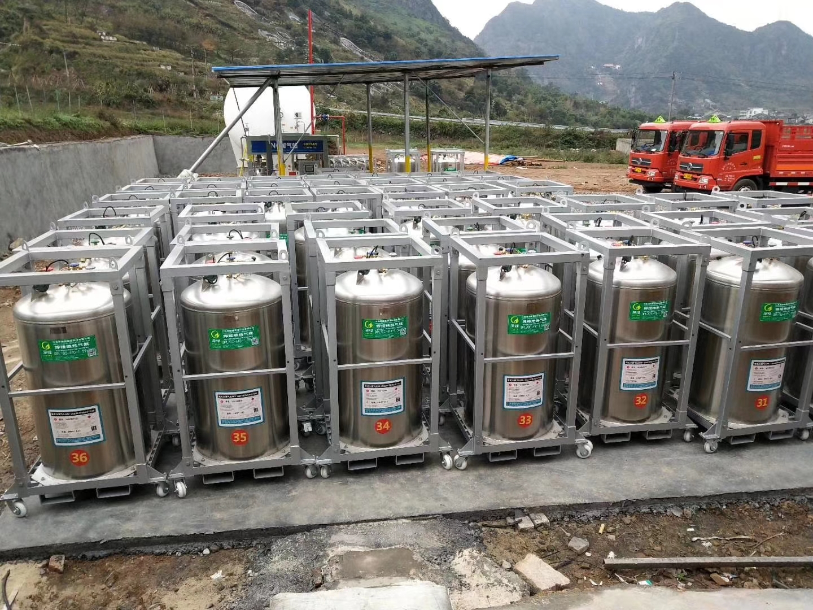
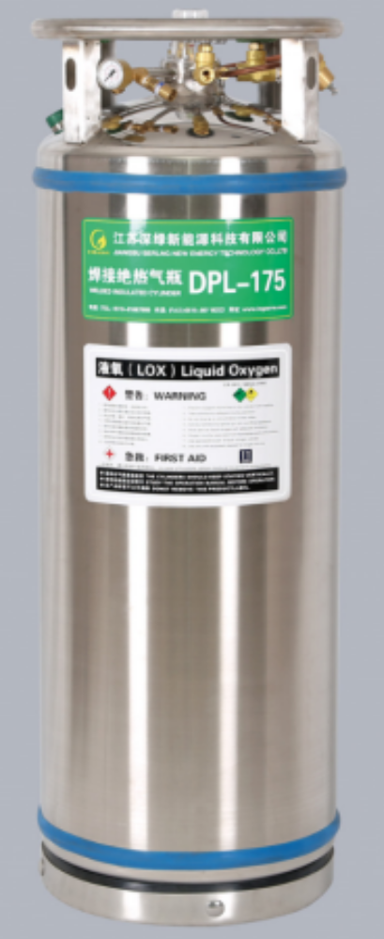
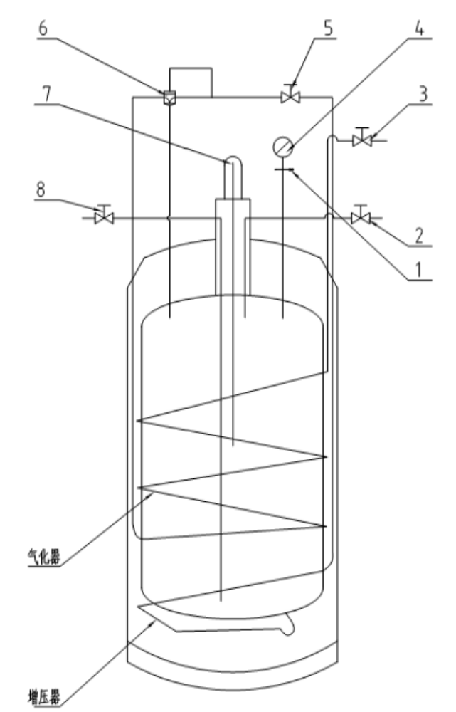
REGO CRYOGINIC PRODUCTS/ LNG TANK MANUFACTURER
SAFETY RELIEF VALVE
DRAIN VALVE
OUTLET VALVE
PRESSURE GAUGE
PRESSURE BUILDER VALVE
COMBINE PRESSURE BUILDER
AND ECONOMIZER
7) LEVEL GAUGE
8) LIQUID IN/OUTLET VALVE
VAPORIZER
BOTTOM OUTLET

Slide 13
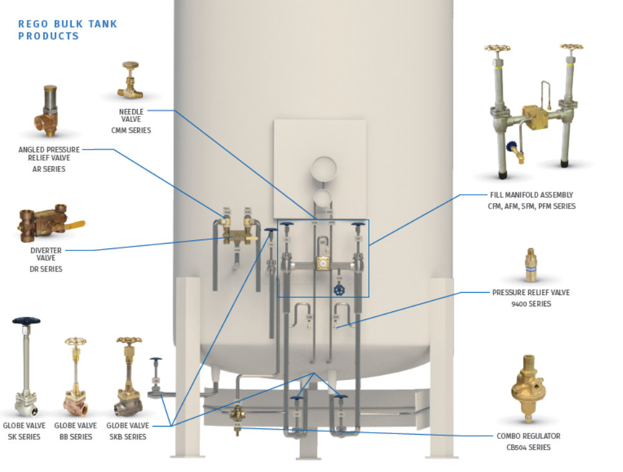
REGO CRYOGINIC PRODUCTS/ LNG TANK MANUFACTURER
NEEDER VALVE
CMM SERIES
ANGLE RELIEF VALVE
AR SERIES
FILL MANIFOLD
CFM, AFM, PFM SERIES
DIVERTER VALVE
DR SERIES
PRESSURE RELIEF VALVE
9400 SERIES
GLOBE VALVE
SK SERIES, SKB SERIES
REGULATOR
CB504 SERIES

Slide 14

LNG TANK MANUFACTURER

Slide 15
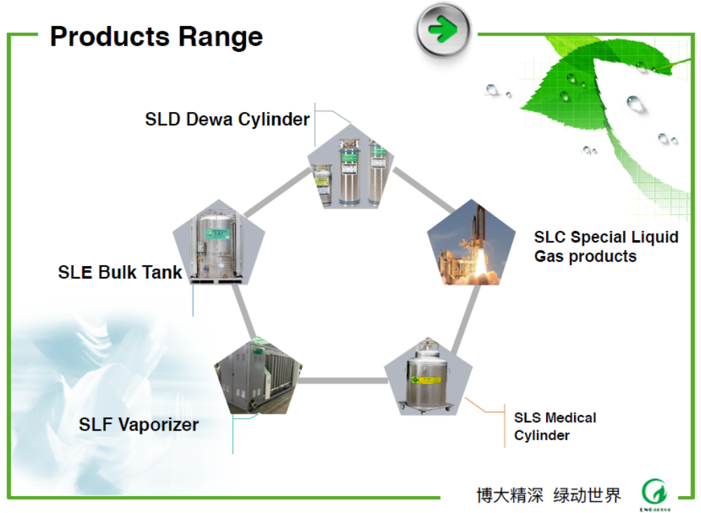
REGO CRYOGINIC PRODUCTS/ LNG TANK MANUFACTURER

Slide 16
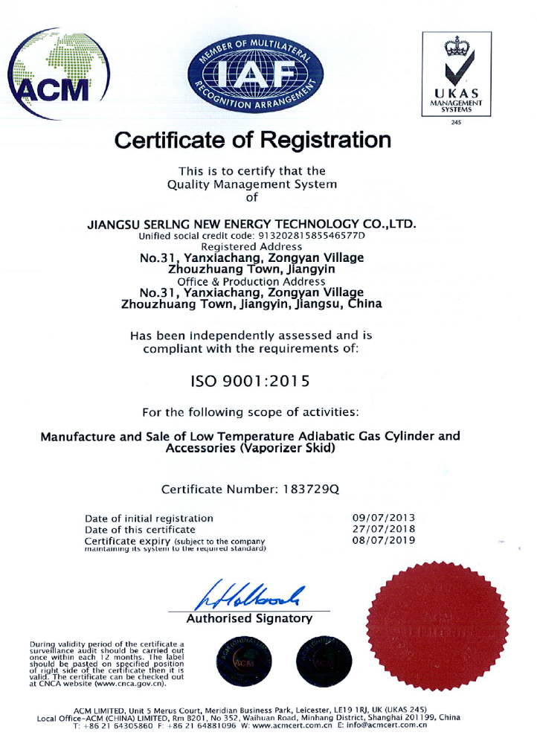
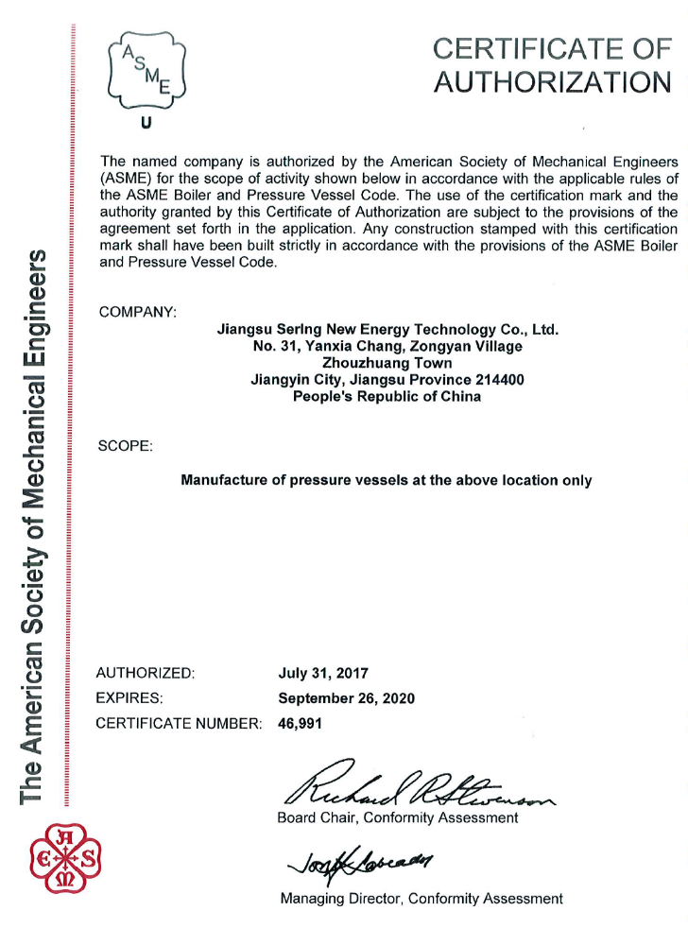
REGO CRYOGINIC PRODUCTS/ LNG TANK MANUFACTURER

Slide 17
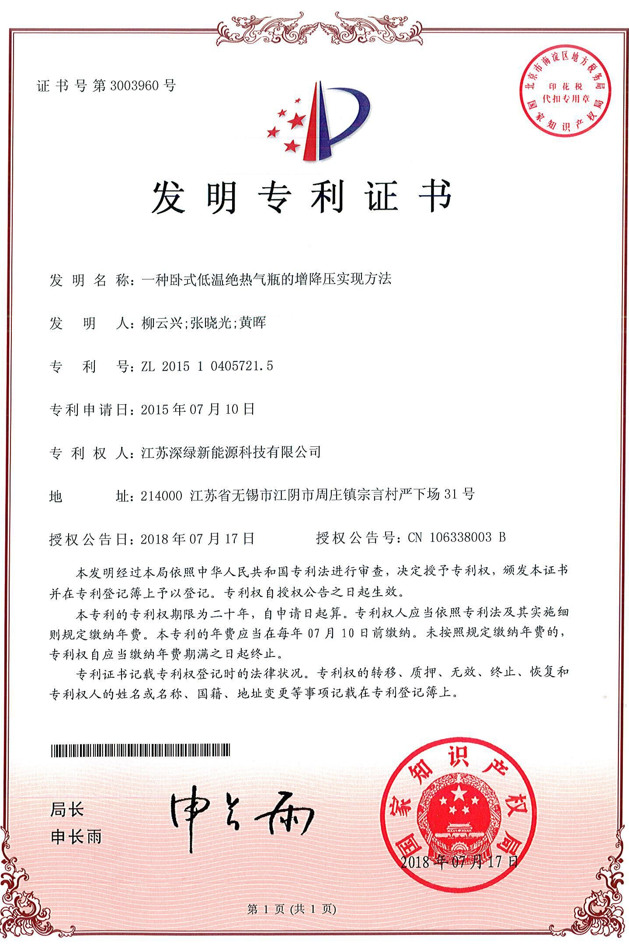
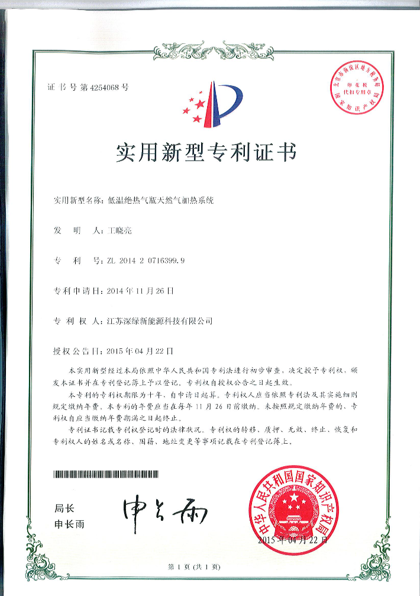
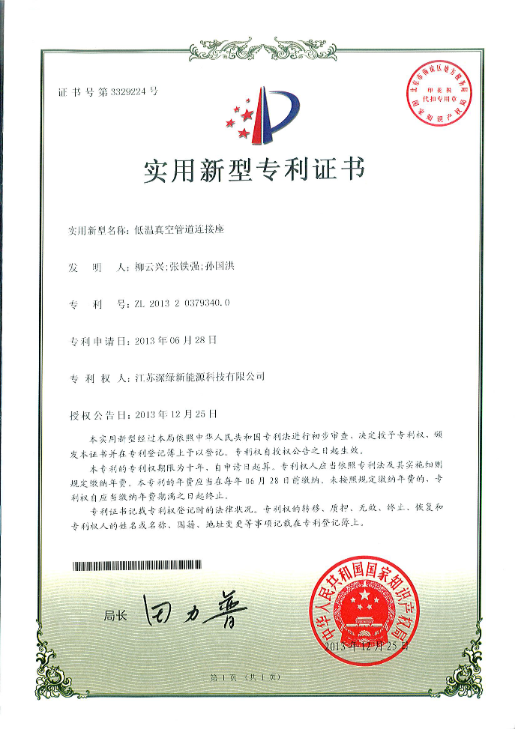
REGO CRYOGINIC PRODUCTS/ LNG TANK MANUFACTURER
PANDENT FOR LOW TEMPERATURE
CYLINDER PRESSURIZE INCREASING
METHOD
PANDENT FOR LOW TEMPERATURE
CYLINDER VACUMN TUBING CONNECTOR
PANDENT FOR LOW TEMPERATURE
CYLINDER DEPRESSURIZE METHOD

Slide 18
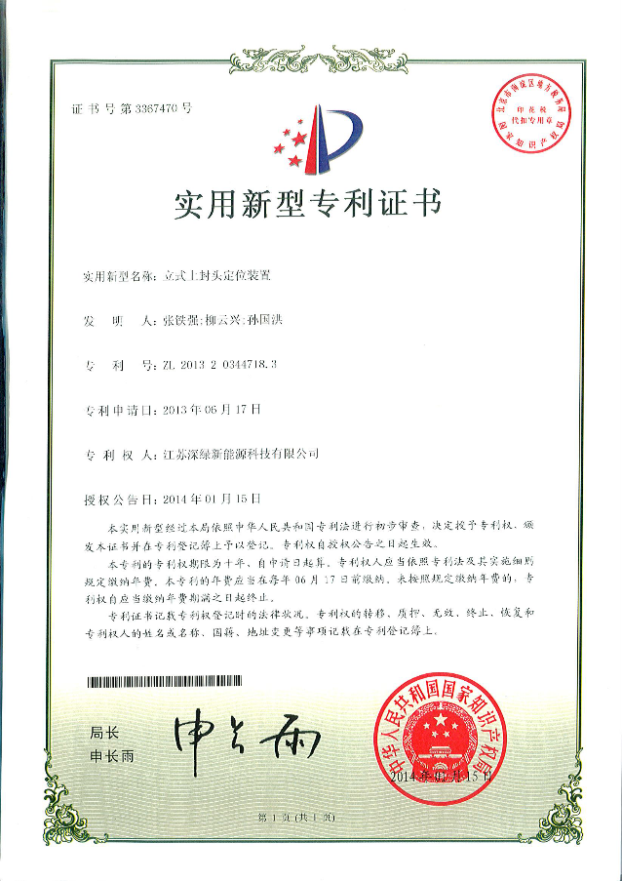
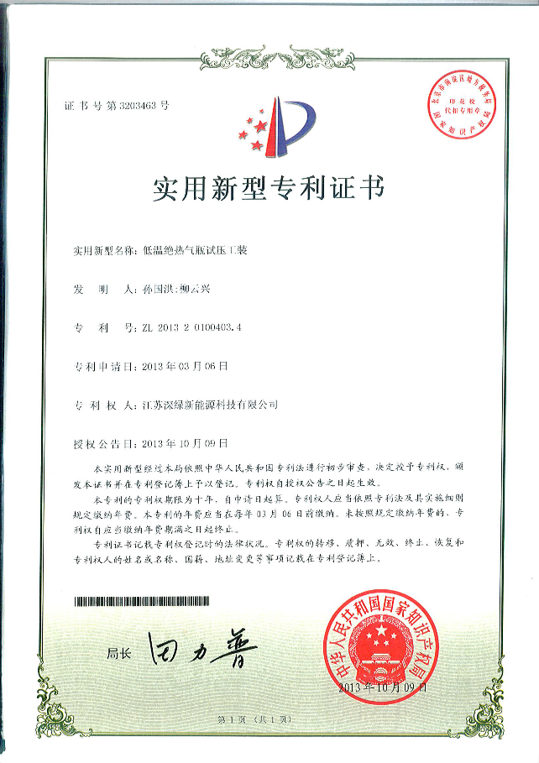
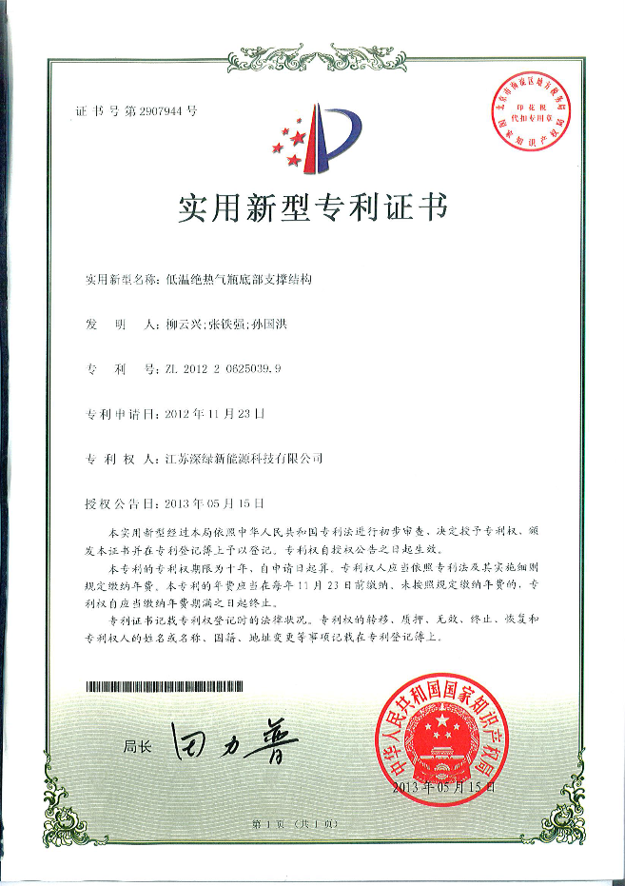
REGO CRYOGINIC PRODUCTS/ LNG TANK MANUFACTURER
LOW TEMP. INSULATION TESTING
METHOD
LOW TEMP. CYLINDER SUPPORTING
METHOD
VERTICLE CYLINDER CONNECTION
AND MORE…….

Slide 19
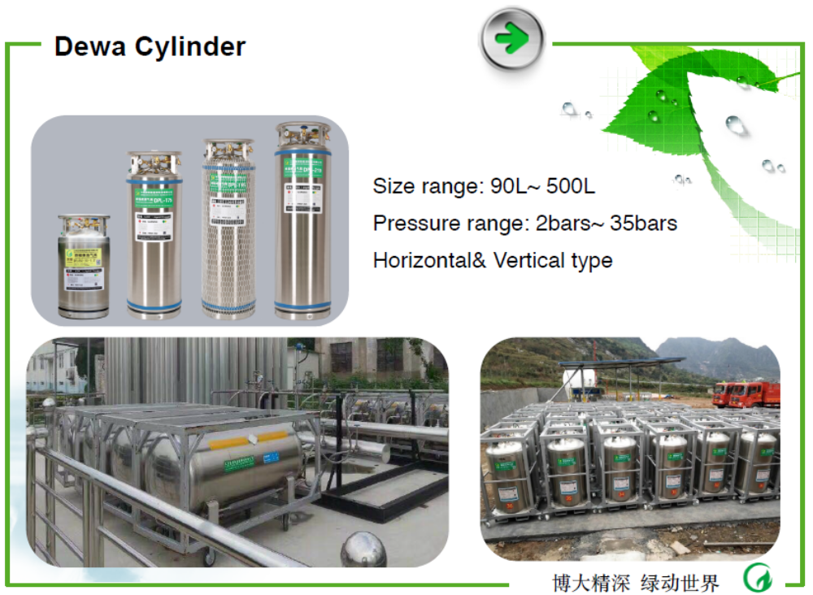
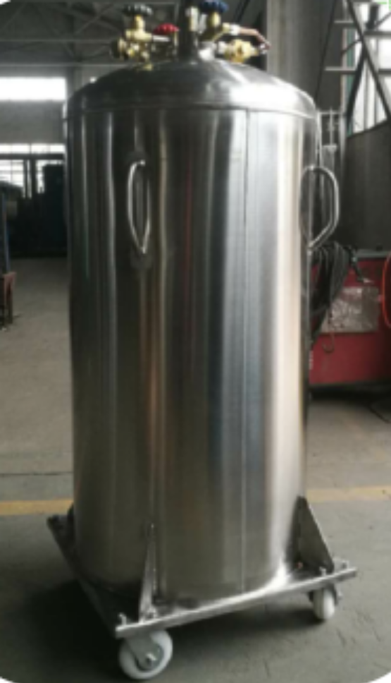
REGO CRYOGINIC PRODUCTS/ LNG TANK MANUFACTURER

Slide 20
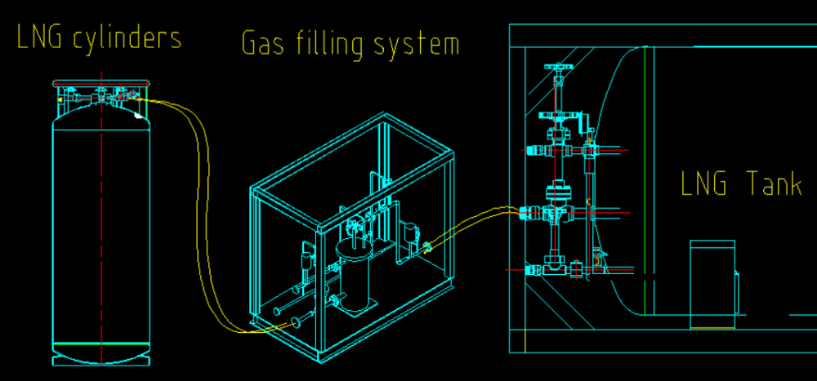
REGO CRYOGINIC PRODUCTS/ LNG TANK MANUFACTURER
FILLING OF LNG CYLINDER

Slide 21
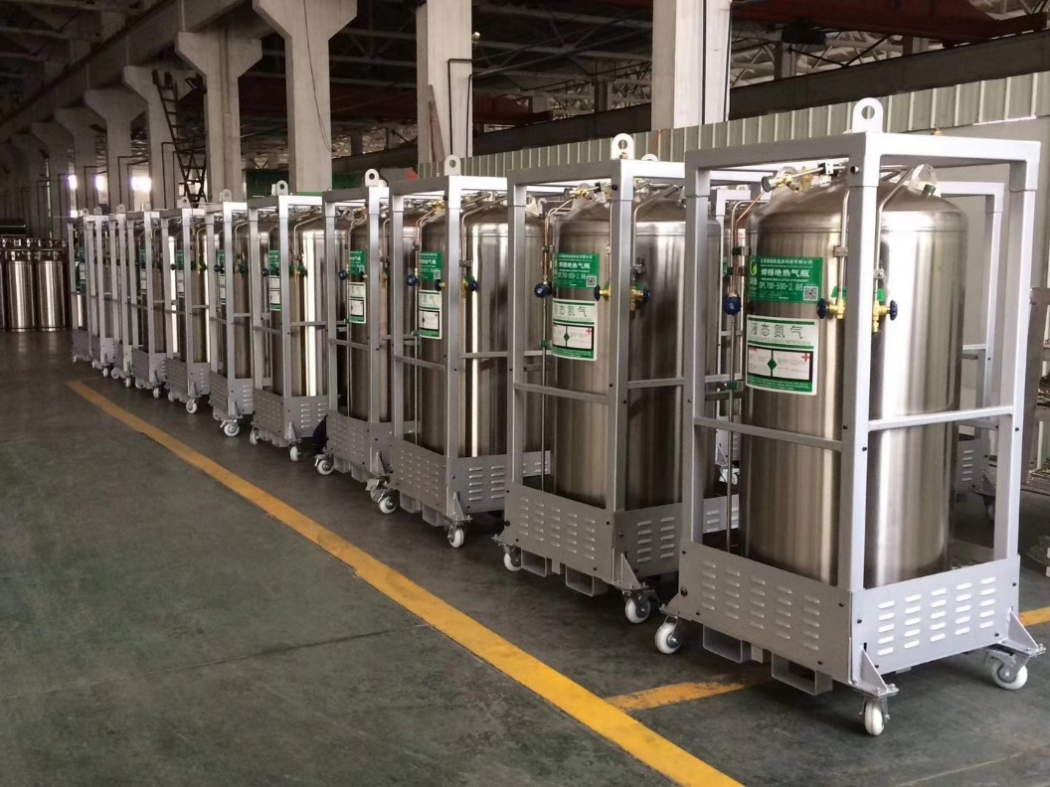

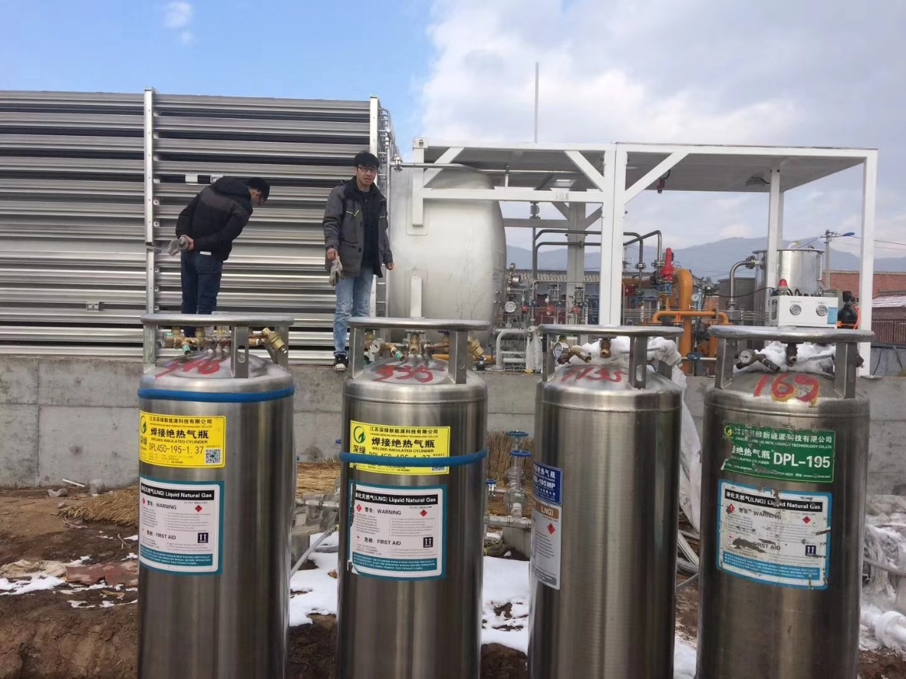
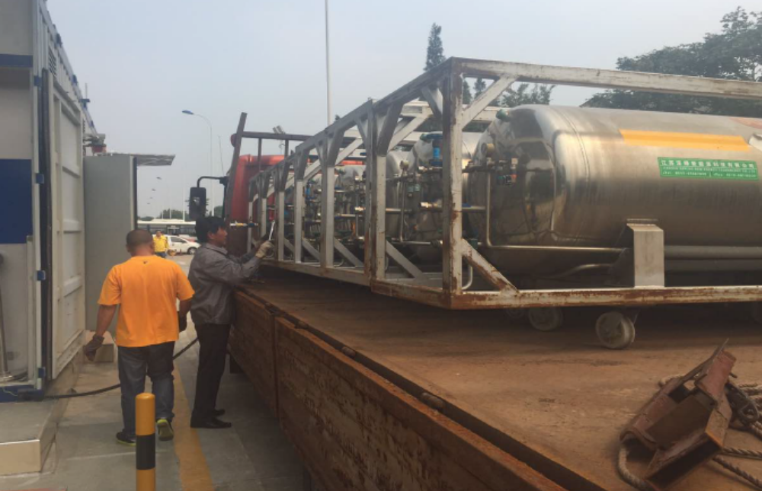
REGO CRYOGINIC PRODUCTS/ LNG TANK MANUFACTURER

Slide 22

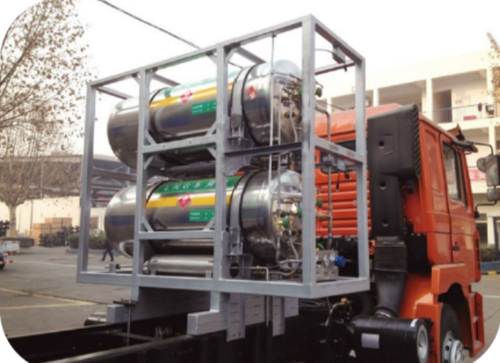
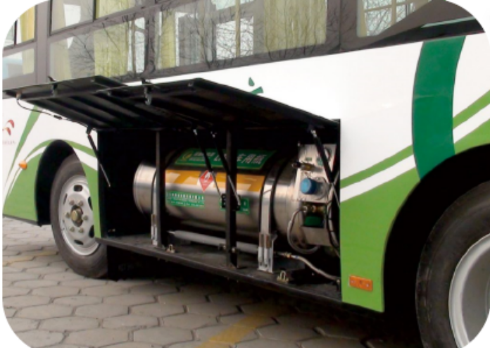
REGO CRYOGINIC PRODUCTS/ LNG TANK MANUFACTURER

Slide 23
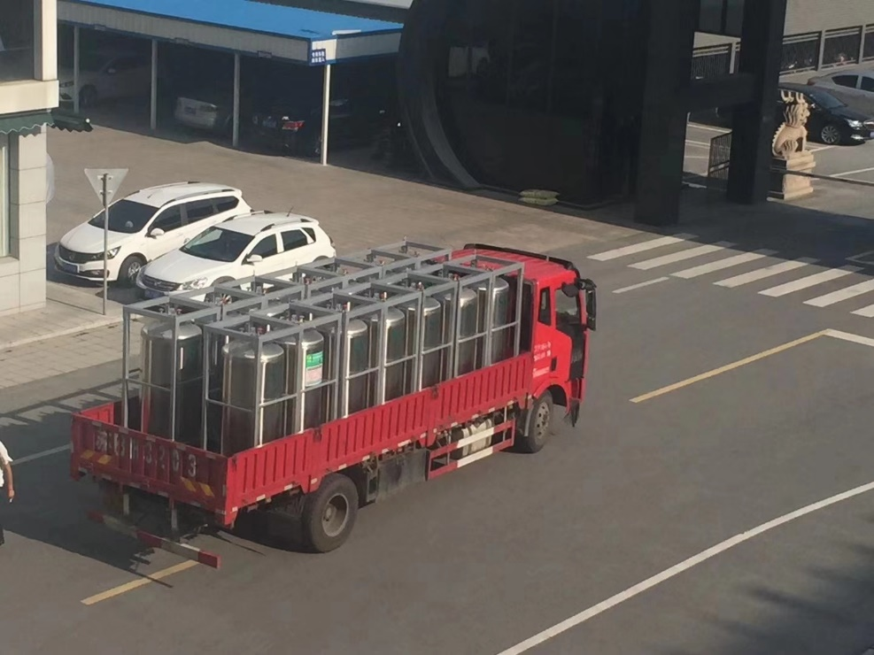
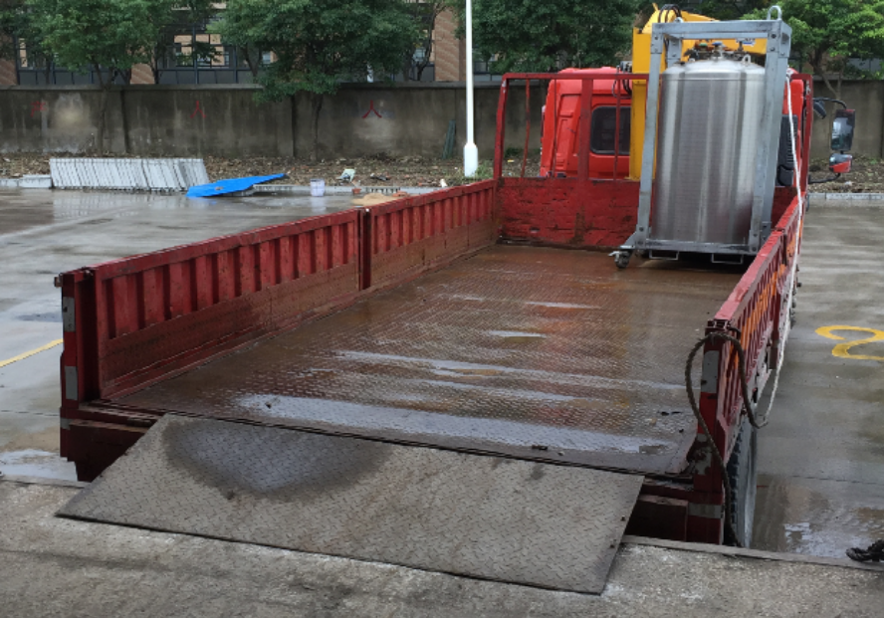
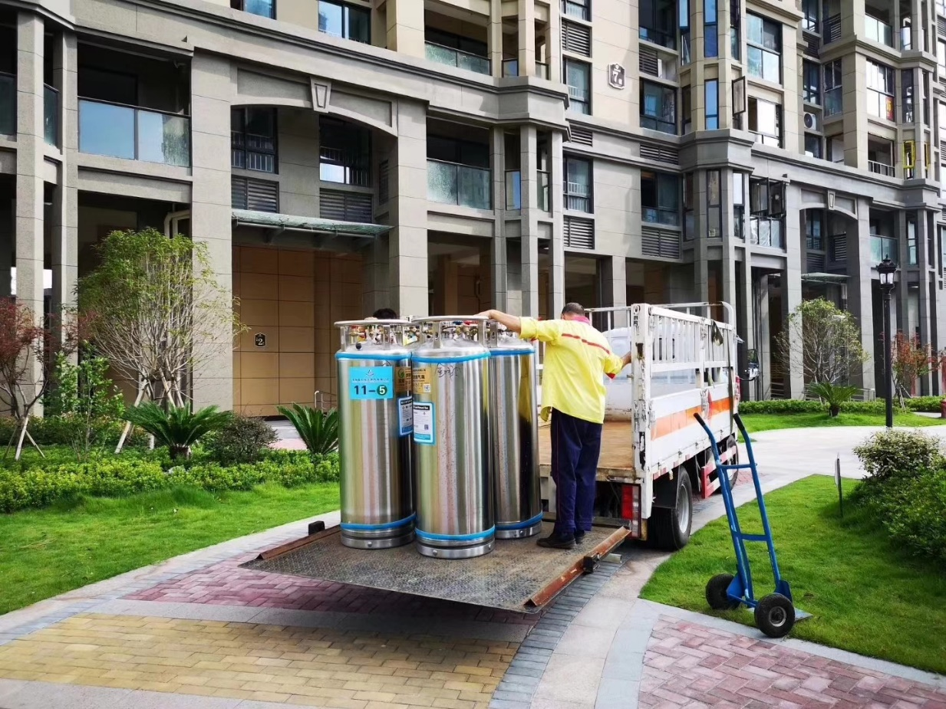
REGO CRYOGINIC PRODUCTS/ LNG TANK MANUFACTURER

Slide 24
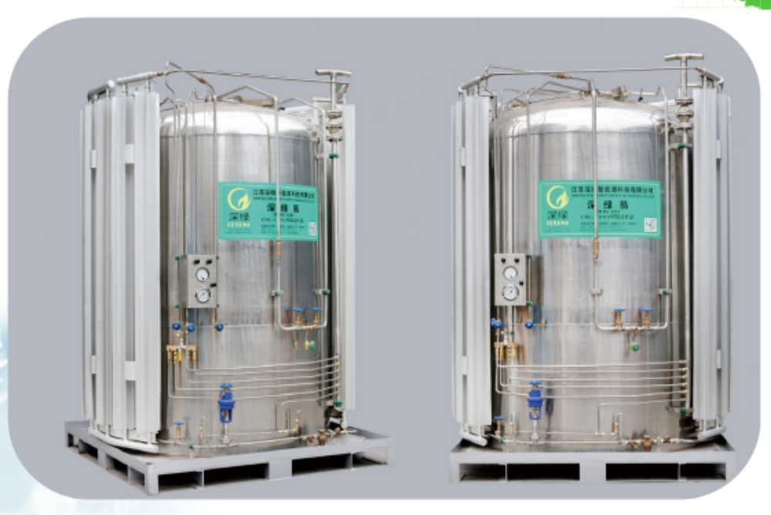
REGO CRYOGINIC PRODUCTS/ LNG TANK MANUFACTURER
Size range: 1000L – 5000L
Pressure range: .8 – 3.5 Mpa
Vertical type

Slide 25
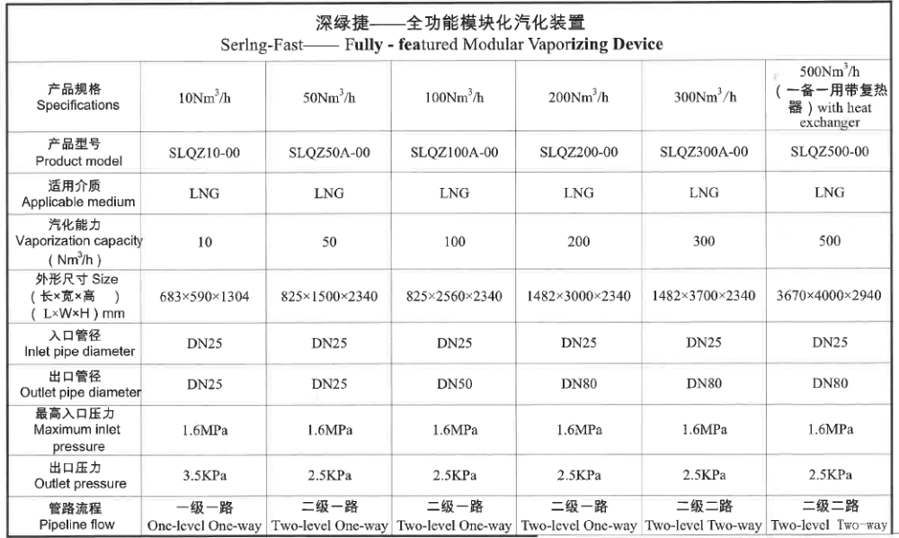
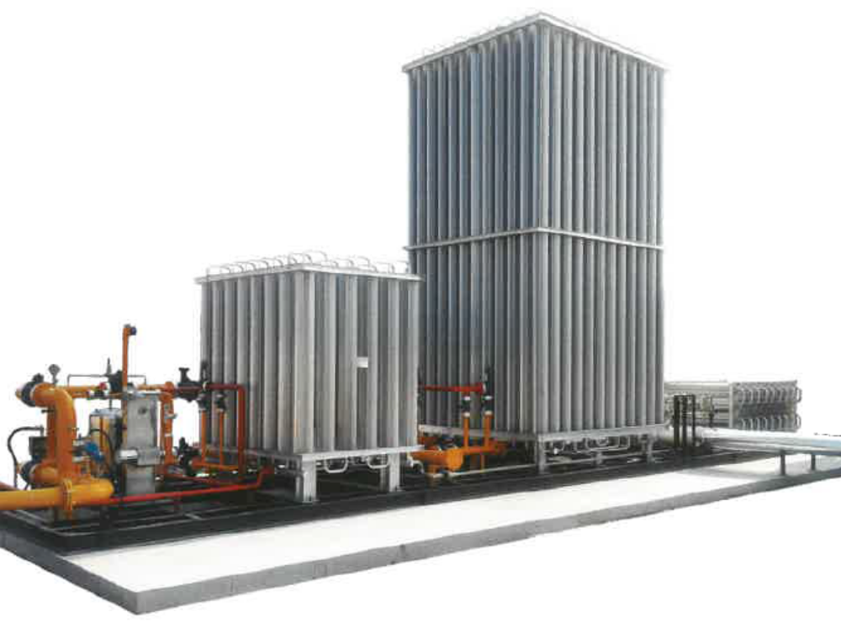
REGO CRYOGINIC PRODUCTS/ LNG TANK MANUFACTURER
Vaporizer to any requested size.
Ambien temperature vaporization

Slide 26
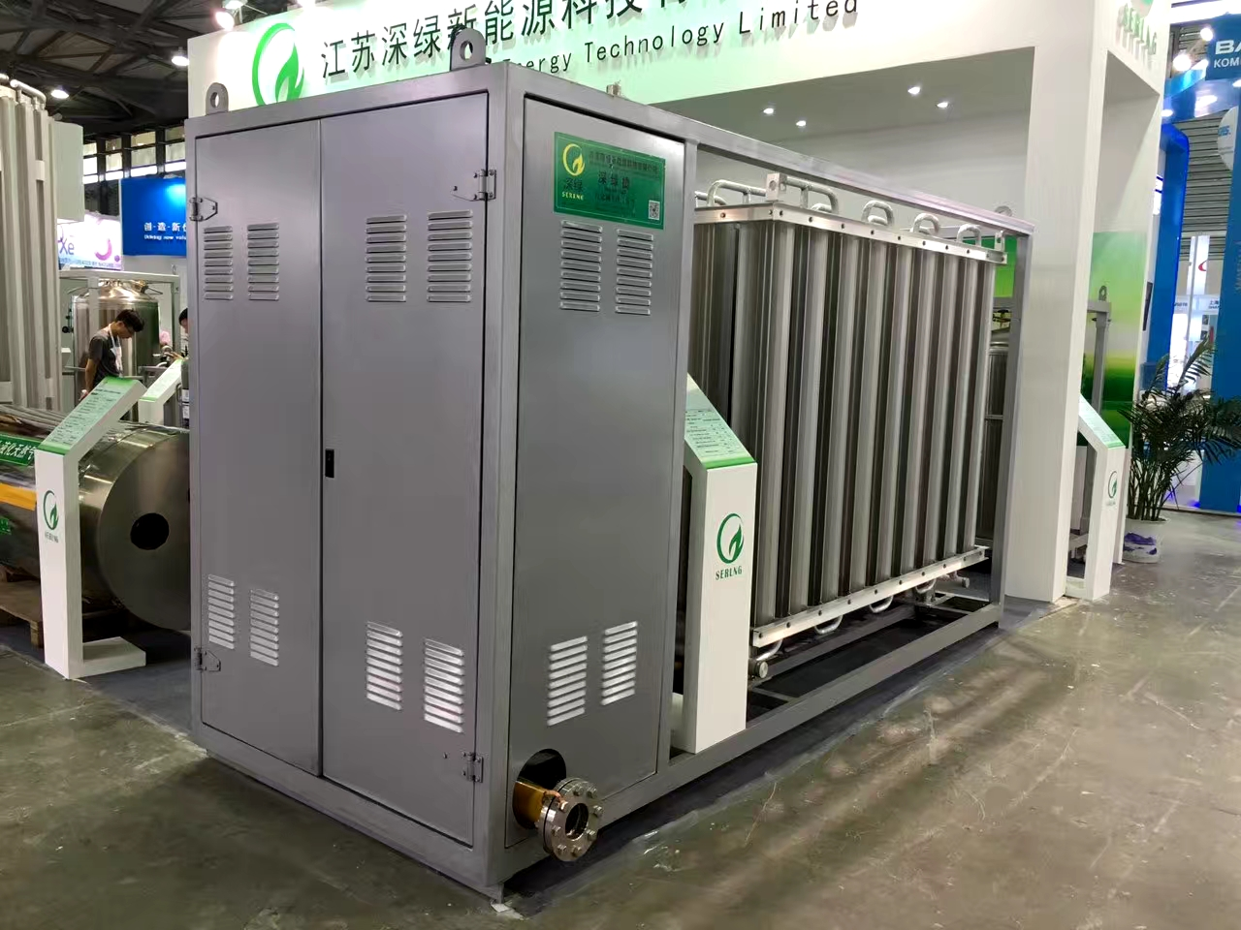



REGO CRYOGINIC PRODUCTS/ LNG TANK MANUFACTURER
Vaporizer to any requested size.
Natural vaporization or Electrical type

Slide 27

REGO CRYOGINIC PRODUCTS/ LNG TANK MANUFACTURER
UNLOADING BOOSTER SKID
TANKS SKID
REGULATING VALVE
VAPORIZER SKID

Slide 28




REGO CRYOGINIC PRODUCTS/ LNG TANK MANUFACTURER
Small/Medium Gas Supply System with Cylinder

Slide 29



REGO CRYOGINIC PRODUCTS/ LNG TANK MANUFACTURER
System design to your required flow rate

Slide 30

LNG TRANSPORTATION
LNG Transportation
Item | Type of gas | Volume (M3) | Model |  | Total weight | Gas weight | Equipment weight | Dimension
 |  |  |  |  | kg | kg | kg | mm
1 | LNG | 20 | ZHJ5300GDY型 | 低温液体运输车 | 29500 | 8095 | 21210 | 11900×2500×3375
2 | LNG | 44 | ZHJ9400GDYA型 | 低温液体运输半挂车 | 39500 | 17800 | 21700 | 12950×2500×3950
3 | LNG | 52.63 | ZHJ9408GDYA型 | 低温液体运输半挂车 | 40000 | 20560 | 19440 | 13000×2500×3995
4 | LNG | 52.63 | ZHJ9380GDYA型 | 低温液体运输半挂车 | 38000 | 22250 | 15750 | 13000×2500×3950
5 | LNG | 56.3 | ZHJ9408GDYC型 | 低温液体运输半挂车 | 40000 | 23850 | 16150 | 13000×2500×3980
Volume：52.6m3
Presure：0.7MPa
Method of colling：Vacuum insulation
Standard：GB、ASME\EN

Slide 31










More then 50 customer…….

Slide 32
METTA LPG PTE LTD
2C JALAN PESAWAT JURONG SINGAPORE 619359
EMAIL: enquiry@mettalpg.com
CONTACT: +65-62654933
THANK YOU

